Slide 1
Rational Unified Process(RUP)

Slide 2
纲要
最好的软件工程实践
关键的概念
UP结构
核心工作流
UML与UP
RUP：过程框架
OOA&OOD的概述

Slide 3
纲要
最好的软件工程实践
关键的概念
UP结构
核心工作流
UML与UP
RUP：过程框架
OOA&OOD的概述

Slide 4
最好的软件工程变化
迭代式开发
管理需求
使用基于组件的体系结构
可视化建模
验证质量
控制变化

Slide 5
纲要
最好的软件工程实践
关键的概念
UP结构
核心工作流
UML与UP
RUP：过程框架
OOA&OOD的概述

Slide 6
关键概念
Worker, Artifact and Activity
A role played by an individual or a team
Activity
A unit of work
Worker
How does it?
Who does it?
Analyst
Describe a
Use Case
responsible for
Artifact
What is produced?
Use case
A piece of information that is produced, modified, or used by a process
Use case package

Slide 7
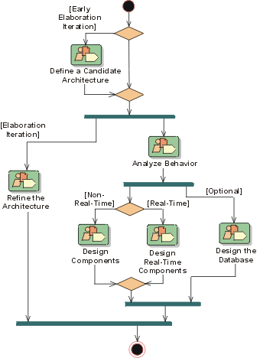
关键概念（续）
工作流（Workflow）
工作流是一活动序列，通过该活动序列的执行，可以产生可观察的价值
When does it?

Slide 8
纲要
最好的软件工程实践
关键的概念
UP结构
核心工作流
UML与UP
RUP：过程框架
OOA&OOD的概述

Slide 9
UP结构
UP结构
生命周期
主要里程碑
阶段和迭代
迭代和工作流

Slide 10
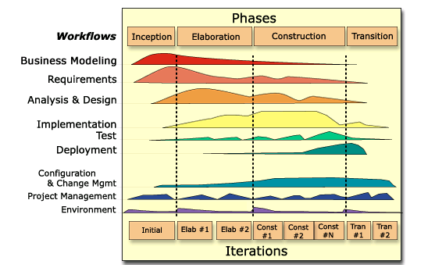
UP 结构
In an iteration, you walk through all workflows
Workflows group activities logically
Notes:
This graphic illustrates how phases and iterations (the time dimension) relate to the development activities (the workflow dimension). The relative size of the color area indicates how much of the activity is performed in each phase/iteration.
Each iteration involves activities from all workflows. The relative amount of work related to the workflows changes between iterations. For instance, during late Construction, the main work is related to Implementation and Test and very little work on Requirements is done.
Note that requirements are not necessarily complete by the end of Elaboration. It is acceptable to delay the analysis and design of well-understood portions of the system until Construction because they are low in risk.
Can iterations overlap?
No. Our model is to show no overlap among iterations. In a large project, several teams may work in parallel on their portions of the iteration, but we do not consider these to be separate iterations.
How many iterations should you have?
It depends on many factors. Err on the side of too many iterations.
Animation note: The callouts and black rectangle appear 2 seconds after the slide.

Slide 11
生命周期
Inception
Elaboration
Construction
Transition
time
UP过程具有四个阶段:
Inception - 定义项目范围
Elaboration – 规划项目，描述特征和基线架构
Construction - Build the product
Transition – 交付产品给终端用户
Notes:
During Inception, we define the scope of the project, what is included, and what is not. We do this by identifying all the actors and use cases, and by drafting the most essential use cases (usually approximately 20% of the complete model). A business plan is developed to determine whether resources should be committed to the project.
During Elaboration, we focus on two things: get a good grasp of the requirements (80% complete), and establish an architectural baseline. If we have a good grasp of the requirements and the architecture, we can eliminate a lot of the risks and will have a good idea what amount of work remains to be done. We can make detailed cost/resource estimations at the end of Elaboration.
During Construction, we build the product in several iterations up to a beta release.
During Transition, we transition the product to the end user and focus on end user training, installation, and support.
The amount of time spent in each phase varies. For a very complex project with a lot of technical unknowns and unclear requirements, Elaboration may include 3-5 iterations. For a very simple project, where requirements are known and the architecture is simple, Elaboration may include only a single iteration.
The student notes are quite extensive. There is no need to go into that much detail in class. The important thing is to understand how the RUP uses phases to organize the lifecycle.
You can also mention that we deliberately chose names that do not match the waterfall names (analysis, design, implementation, and test) to emphasize that they are NOT the same as the waterfall phases.
Some ways of describing the phases in common terminology:
Inception -- bid and proposal
Elaboration -- building blueprints
Construction -- I think I’m done
Transition -- how do users react?

Slide 12
主要里程碑
Inception
Elaboration
Construction
Transition
time
Lifecycle
Objective
Milestone
Lifecycle
Architecture
Milestone
Initial Operational
Capability
Milestone
Product
Release
Notes:
At each of the major milestones, we review the project and decide whether to proceed with the project as planned, to abort the project, or to revise it. The criteria used to make this decision vary by phase.
The evaluation criteria for the inception phase (LCO) include: stakeholder concurrence on scope definition and cost/schedule estimates; requirements understanding as evidenced by the fidelity of the primary use cases; credibility of cost/schedule estimates, priorities, risks, and development process; depth and breadth of any architectural prototype; actual expenditures versus planned expenditures.
The evaluation criteria for the elaboration phase (LCA) include: stability of the product vision and architecture; resolution of major risk elements; adequate planning and reasonable estimates for project completion; stakeholder acceptance of the product vision and project plan; acceptable expenditure level.
The evaluation criteria for the construction phase (IOC) include: stability and maturity of the product release (i.e., is it ready to be deployed?); readiness of the stakeholders for the transition; acceptable expenditure level.
At the end of the transition phase, we decide whether to release the product. We base this primarily on the level of user satisfaction achieved during the transition phase. Often this milestone coincides with the initiation of another development cycle to improve or enhance the product. In many cases, this new development cycle may already be underway.
The student notes are extensive, and there is no need to go into detail with each milestone. The most important point to get across is that there are formal milestones marking major decision points with the RUP lifecycle just like there is in the waterfall.
The criteria listed in the student notes are extensive because they are thorough. However, only one or two of the criteria at each point are really important. The ones to emphasize are:
LCO: scope agreed upon and risks understood and reasonable
LCA: high risks addressed and architecture stable
IOC: product is complete and quality acceptable

Slide 13
迭代和阶段
Inception
Elaboration
Construction
Transition
Preliminary
Iteration
Architect.
Iteration
Architect.
Iteration
Devel.
Iteration
Devel.
Iteration
Devel.
Iteration
Transition
Iteration
Transition
Iteration
Minor Milestones: Releases
An iteration is a distinct sequence of activities based on an established plan and evaluation criteria, resulting in an executable release (internal or external).
Notes:
Within each phase, there is a series of iterations. The number of iterations per phase will vary. Each iteration results in an executable release encompassing larger and larger subsets of the final application.
An internal release is kept within the development environment and (optionally) demonstrated to the stakeholder community. We provide stakeholders (usually users) with an external release for installation in their environment. External releases are much more expensive (they require user documentation and technical support) and normally occur only during the transition phase.
The end of an iteration marks a minor milestone. At this point, we assess technical results and revise future plans as necessary.

Slide 14
纲要
最好的软件工程实践
关键的概念
UP结构
核心工作流
UML与UP
RUP：过程框架
OOA&OOD的概述

Slide 15
核心工作流
核心过程工作流
业务建模
需求
分析和设计
实现
测试
部署
核心支持工作流
配置和变更管理
项目管理
环境

Slide 16
工作流细节: Requirements - Define the System
Notes:
An artifact is a work product of the process: roles use artifacts to perform activities, and produce artifacts in the course of performing activities. Artifacts are the responsibility of a single role, to promote the idea that every piece of information in the process must be the responsibility of a specific person. Even though one person may "own" the artifact, many other people may use the artifact, perhaps even updating it if they have been given permission.
The workflow detail diagram shows a set of activities that often are done “together.” It also shows input and output artifacts (indicated with arrows), as well as the roles involved.

Slide 17
纲要
最好的软件工程实践
关键的概念
UP结构
核心工作流
UML与UP
RUP：过程框架
OOA&OOD的概述

Slide 18
在UP中使用UML
Notes:
The Rational Unified Process is a model-driven approach. Several models are needed to fully describe the evolving system. Each major workflow produces one of those models. The models are developed incrementally across iterations.
The Business Model is a model of what the business processes are and the business environment. It can be used to generate requirements on supporting information systems.
The Use-Case Model is a model of what the system is supposed to do and the system environment.
The Design Model is an object model describing the realization of use cases. It serves as an abstraction of the implementation model and its source code.
The Implementation Model is a collection of components, and the implementation subsystems that contain them.
The Test Model encompasses all of the test cases and procedures required to test the system.
You can relate this back to previous slides that describe the system model and the many diagrams needed to fully communicate its content. One can consider all of the models listed here, taken together, to be “the system model.”
The only model that is a little different is the business model. It describes the business at large, not just the automated part. The other models describe the information system that supports the business model.
It is a good idea to point out that each of these models is incrementally developed across many iterations.

Slide 19
纲要
最好的软件工程实践
关键的概念
UP结构
核心工作流
UML与UP
RUP：过程框架
OOA&OOD的概述

Slide 20
UP是过程框架
没有普适的过程
UP是为灵活性和可扩展性而设计的
允许各种各样的生命周期策略
产生的制品（artifacts）是可选择的
定义活动和员工（activity and worker）
模型概念

Slide 21
纲要
最好的软件工程实践
关键的概念
UP结构
核心工作流
UML与UP
RUP：过程框架
OOA&OOD的概述

Slide 22
分析和设计的目的
把需求转变为系统设计
得到具有可靠性的系统架构
使设计满足实现环境，满足性能要求

Slide 23
分析和设计概述
Design Model
Use-Case Model
Analysis and Design
Architecture
Document
Glossary
Supplementary
Specification
Data Model
Notes:
The input artifacts are the Use-Case Model, Glossary, and Supplementary Specification from the Requirements workflow. The result of analysis and design is a Design Model that serves as an abstraction of the source code; that is, the design model acts as a "blueprint" of how the source code is structured and written. The Design Model consists of design classes structured into design packages; it also contains descriptions of how objects of these design classes collaborate to perform use cases (use-case realizations).
The design activities are centered around the notion of architecture. The production and validation of this architecture is the main focus of early design iterations. Architecture is represented by a number of architectural views. These views capture the major structural design decisions. In essence architectural views are abstractions or simplifications of the entire design, in which important characteristics are made more visible by leaving details aside. The architecture is an important vehicle not only for developing a good design model, but also for increasing the quality of any model built during system development. The architecture is documented in the Architecture Document.
The development of the Architecture Document is out of the scope of this course, but we will discuss it’s contents and how to interpret them.
If a separate analysis model is desired, then an Analysis Model would be listed as a separate artifact (in addition to the Design Model).

Slide 24
分析与设计
分析：
理解问题
理想设计
行为
系统结构
功能需求
小模型
设计：
理解解决方案
行为和属性
性能
Close to real code
对象生命周期
非功能需求
大模型

Slide 25
分析和设计不是 Top-Down or Bottom-Up
Top
Down
Subsystems
Bottom
Up
Use Cases
Design Classes
Notes:
Analysis and design is not top-down or bottom-up.
The use case comes in from the left and defines a middle level.
The analysis classes are not defined in a top-down pattern or a bottom-up pattern, they are in the middle. From this middle level one may move up or down.
Defining subsystems is moving up and defining design classes is moving down.
Analysis is both top-to-middle, middle-up, middle-down and bottom-to-middle. There is no way of saying that one path is more important than another - you have to travel on all paths to get the system right.
All of these four paths are equally important. That is why the bottom-up and top-down question can´t be solved.

Slide 26
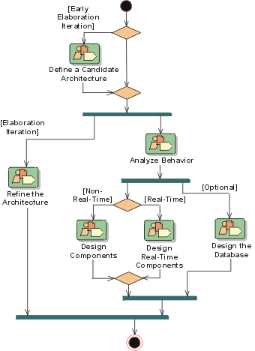
分析和设计工作流
Notes:
A mere enumeration of all workers, activities and artifacts does not constitute a process. We need a way to describe the activities, some valuable result, and interactions between workers. A workflow is a sequence of activities that produces a result of observable value.
In UML terms, a workflow can be expressed as a sequence diagram, a collaboration diagram, or an activity diagram. We use a form of activity diagram in the Rational Unified Process. For each core workflow, an activity diagram is presented. This diagram shows the workflow, expressed in terms of workflow details.
This slide shows the Analysis and Design workflow. The early Elaboration Phase focuses on creating an initial architecture for the system (Define a Candidate Architecture) to provide a starting point for the main analysis work. If the architecture already exists (either because it was produced in previous iterations, in previous projects, or is obtained from an application framework), the focus of the work changes to refining the architecture (Refine the Architecture) and analyzing behavior and creating an initial set of elements which provide the appropriate behavior (Analyze Behavior).
After the initial elements are identified, they are further refined. Design Components and Design Real-Time Components produce a set of components which provide the appropriate behavior to satisfy the requirements on the system. In parallel with these activities, persistence issues are handled in Design the Database. The result is an initial set of components which are further refined in the Implementation Workflow.
Each workflow contains RUP activities that can take place. RUP activities can exist in many different workflow activities. For example, Use-Case Analysis can be found in both Define a Candidate Architecture and Analyze Behavior.

Slide 27
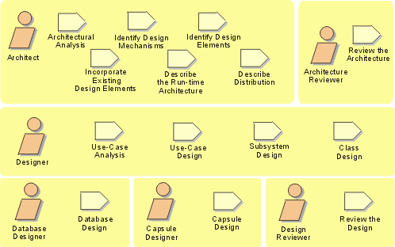
分析和设计活动概览
Notes:
Remember, for analysis and design, we start out with the use-case model and the supplementary specifications from the Requirements workflow and end up with the design model that serves as an abstraction of the source code.
The design activities are centered around the notion of architecture. The production and validation of this architecture is the main focus of early design iterations. The architecture is an important vehicle not only for developing a good design model, but also for increasing the quality of any model built during system development.
The focus of this course is on the activities of the Designer. The Architect’s activities will be discussed, but many of the architectural decisions will be “given”. Each of the Architect and Designer activities will be addressed in individual course modules.
Walk the students through the activities reviewing the meaning of the representational icons (e.g., workers, activities). Activities can be considered operations on the workers.
The order shown is not the order in which the activities can be executed. The analysis and design workflow helps to dictate order.
The process as described in this course develops a design model, not a separate analysis model. To maintain a separate analysis model, some modifications to the process would be necessary, the discussion of which is out of the scope of this course.
Emphasize the Use-Case Analysis activity and how it describes a process for finding classes and objects from use cases. Some people have called it: 'closing the traceability gap’ -- use cases and scenario's help you get from requirements to objects.

Slide 28
开发人员及他们的职责
Use-Case
Realization
Architect
Designer
Package/ Subsystem
Design Model
Class
Software Architecture
Document
Design
Reviewer
Data Model
Database Designer
Architecture
Reviewer
Notes:
Again, the focus of this course is on the activities and artifacts of the Designer.
The Architect leads and coordinates technical activities and artifacts throughout the project. The Architect establishes the overall structure for each architectural view: the decomposition of the view, the grouping of elements, and the interfaces between these major groupings. Thus, in contrast with the other workers, the Architect's view is one of breadth, as opposed to depth.
A Designer defines the responsibilities, operations, attributes, and relationships of one or several classes and determines how they should be adjusted to the implementation environment. A Designer may have responsibility for one or more Design Packages or Design Subsystems, including any classes owned by the packages or subsystems. A Designer may be responsible for a Use-Case Realization, in order to ensure the overall consistency of how a particular use case is realized using the design elements.
The Database Designer defines the tables, indexes, views, constraints, triggers, stored procedures, table spaces or storage parameters, and other database-specific constructs needed to store, retrieve, and delete persistent objects. This information is maintained in the Data Model.
The Architecture Reviewer plans and conducts the formal reviews of the software architecture in general.
The Design Reviewer plans and conducts the formal reviews of the design model.

